Slide 1

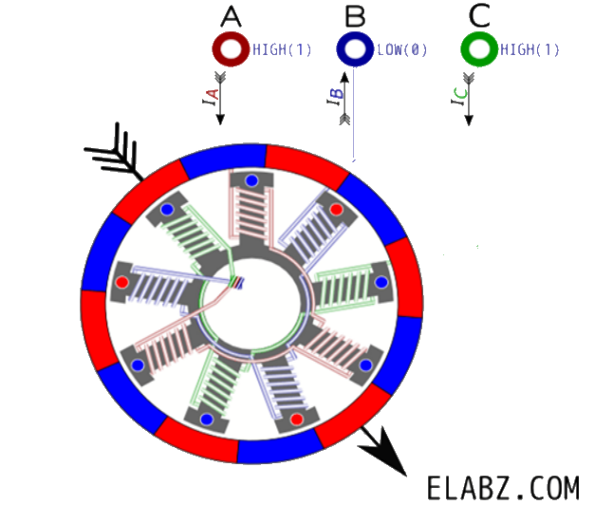
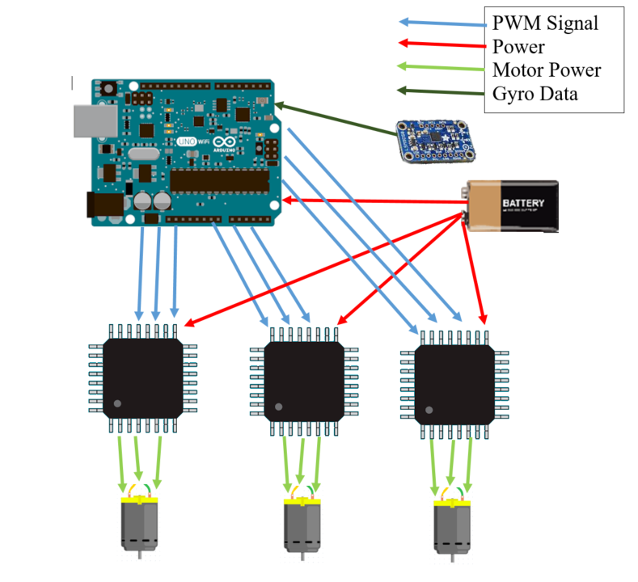
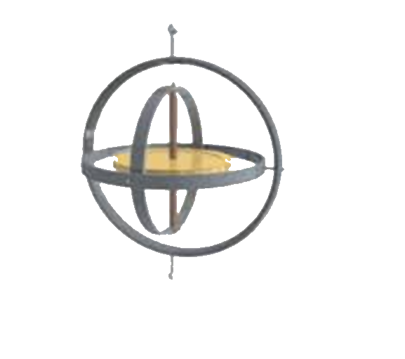
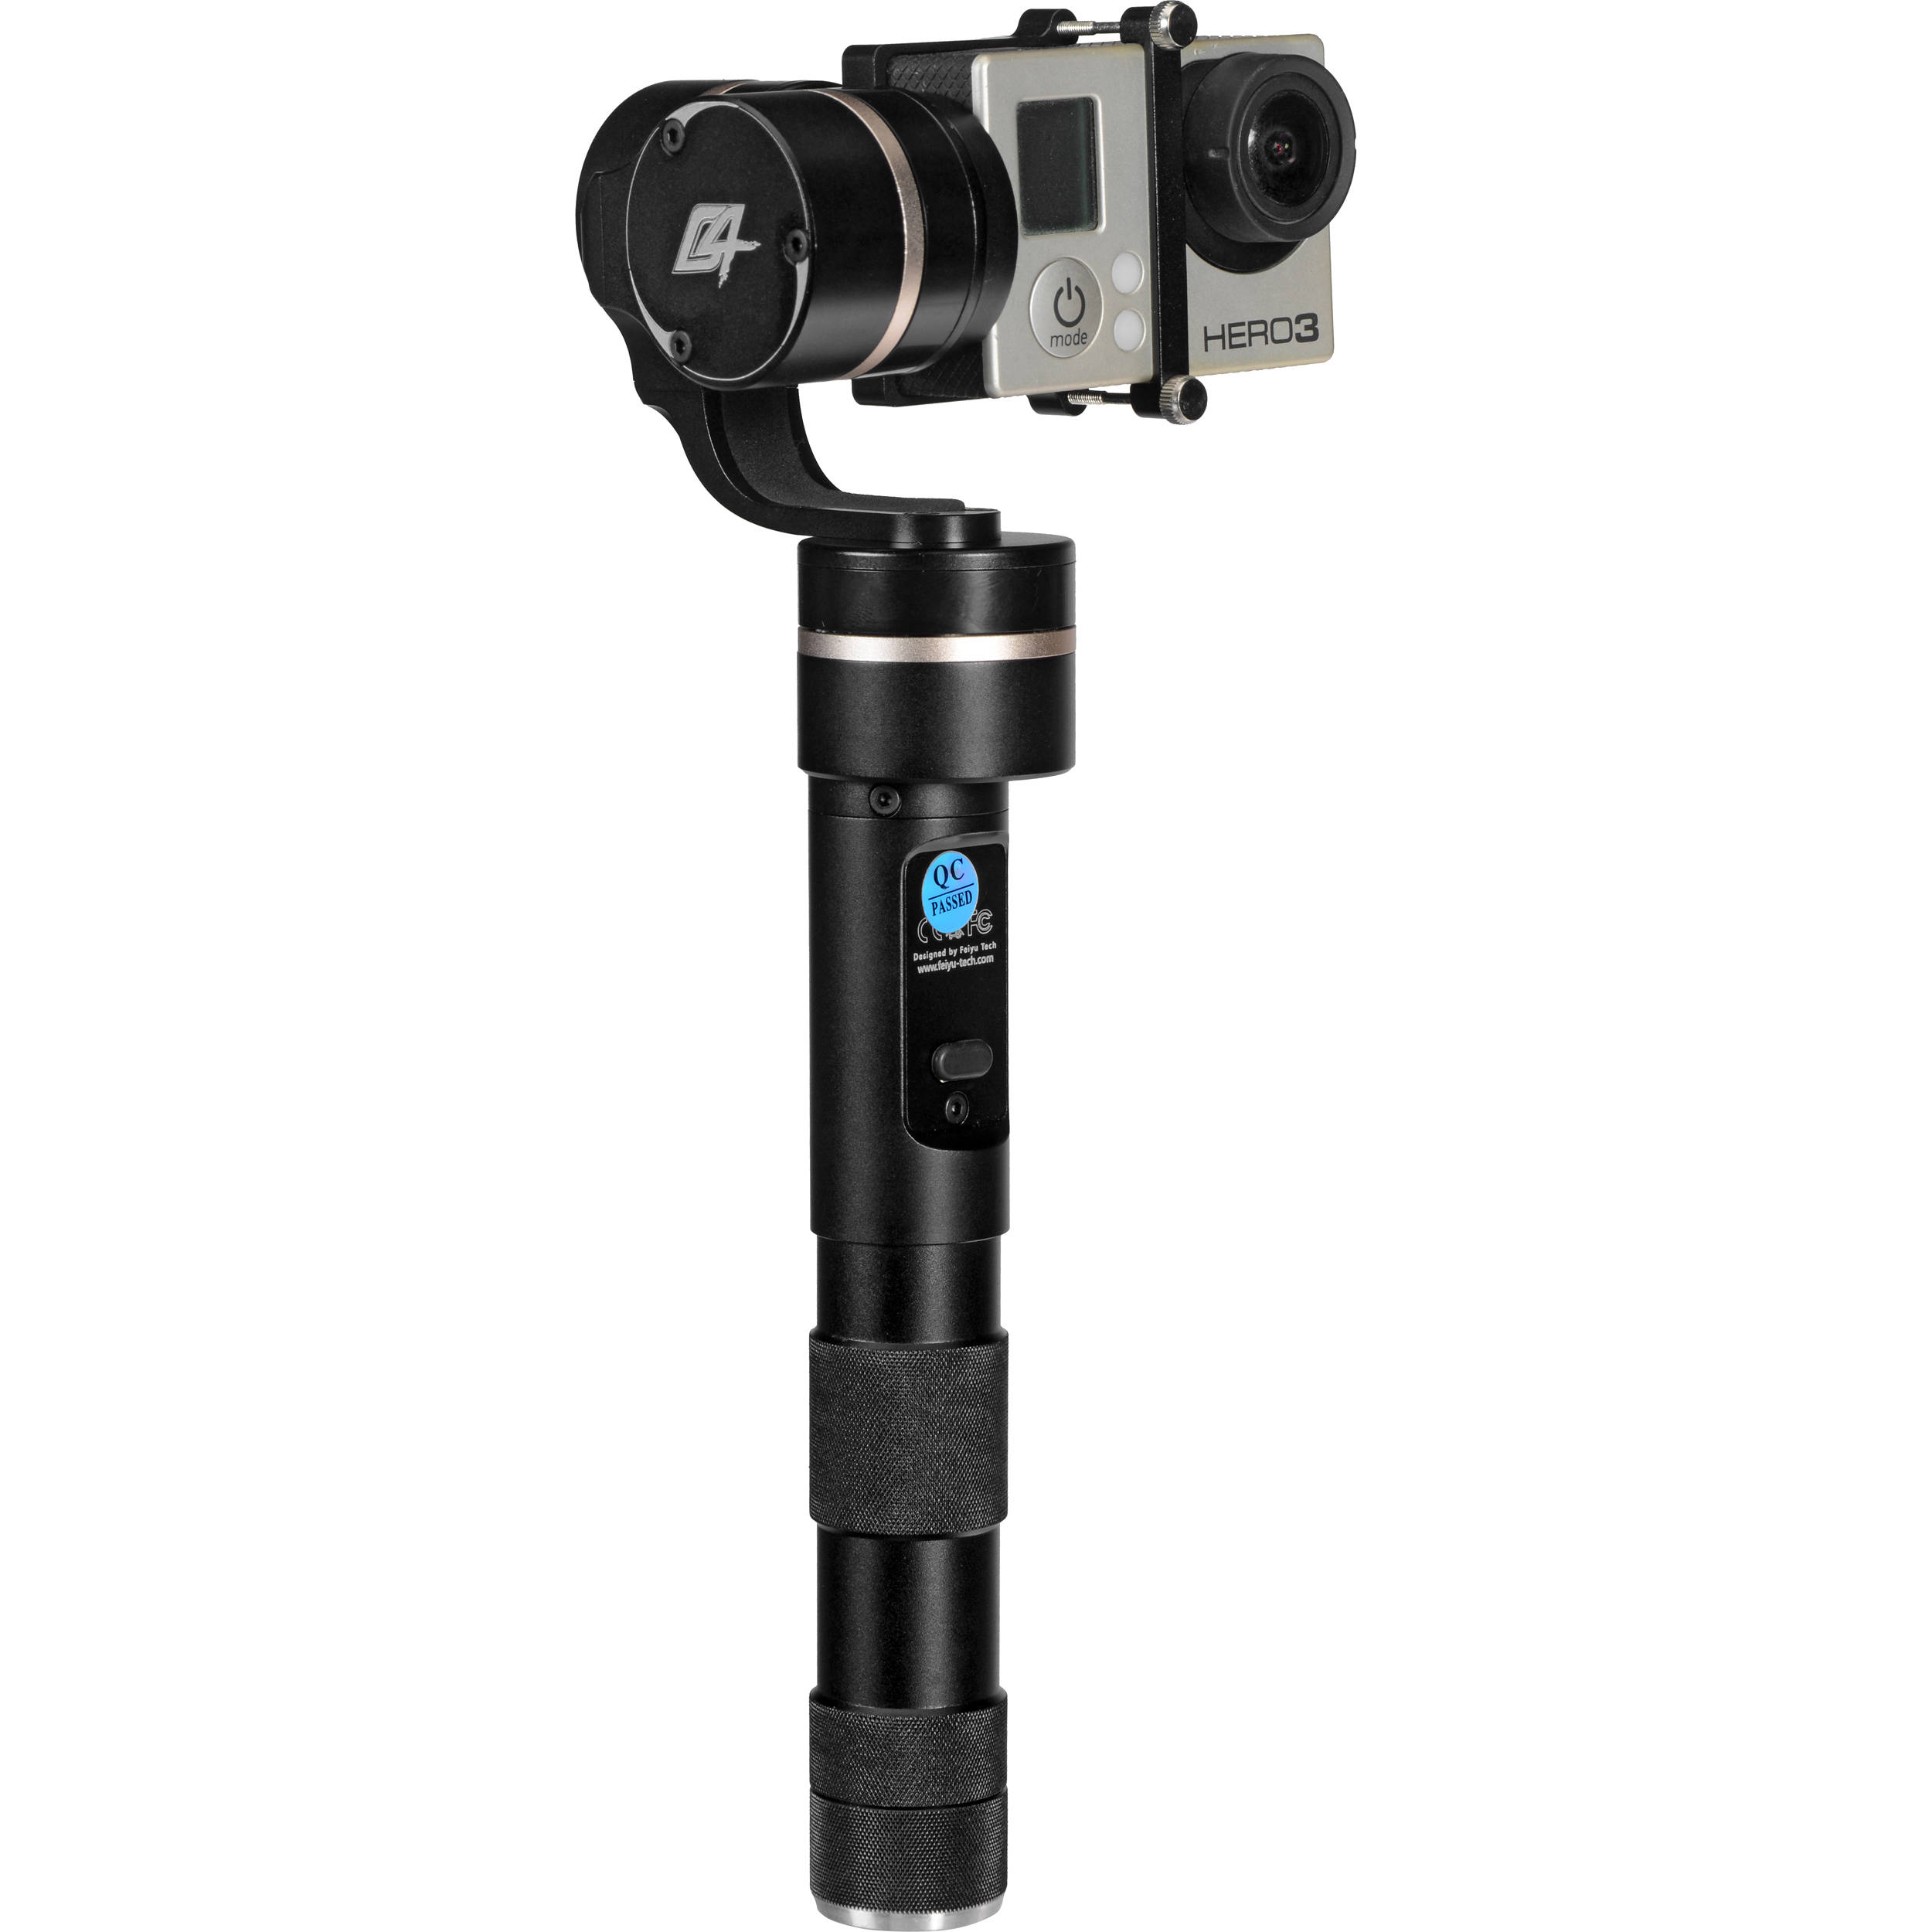
Gimbal Camera Stabilizer
Developing a 3-Axis Camera Stabilizer with an Arduino and BLDC Motors
Robert Arnold
Computer Science University of North Carolina Wilmington
MOTOR CONTROL
Introduction
Implementation
Camera stabilizers are becoming increasingly important in amateur film and photography. This project explores the concepts behind stabilization and brushless DC motor control. The outcome is to create an easy to implement and low cost gimbal camera stabilizer, through the use of three powered gimbals.
What is a Gimbal?
HOW DOES A BLDC MOTOR WORK?
BLDC stands for Brush Less Direct Current
The motor is made up of stator coils and permanent magnets
By passing a current through the stator coils, an electromagnetic field is generated. The permanent magnets will react with this field by pushing or pulling the stator coil depending on the current sent through the stator coil
For this application an outrunner design is used in the motor where the stator coils are stationary as the core of the motor and the permanent magnets rotate on the outside of the stators
CONTROLLING A BLDC MOTOR
A gimbal is a pivoted support that allows an object to rotate around a specified axis
The picture to the left is an example of a 3-axis gimbal where all 3 axis’ are orthogonal to each other
from Wikipedia.com
INITIALIZATION
The Gimbal must initially be placed in a known orientation, such as face down on a flat table
Next, the motors will rotate to a preset orientation
This eliminates the need to use hall-sensors to keep track of the rotor position, since we are starting with a known orientation and state
What is a ‘powered’ Gimbal?
Digital
Only utilizes on and off states for each stator
This provides an easy and comprehendible implementation for the motor control
The downside is that the motor has choppy movement at most speeds
Pulse Width Modulation
Implements many more states and the duty cycle follows a sinusoidal pattern to create smooth and precise operation of the motor
A high duty cycle will provide more voltage and current than a low duty cycle
A ‘powered’ gimbal controls the objects rotation around a specified axis
The gimbal camera stabilizer will utilize three brushless DC motor powered gimbals
The image below is an example of what the end product will resemble
ARDUINO LOGIC
The Arduino will receive data from a gyroscope sensor that determines how far the camera has rotated along a given axis
This data is then fed into a PID function to calculate how many the steps the motor must make, and in which direction, to move the camera back to the desired orientation
This data is then fed into the motor controller which rotates the motor appropriately
From Google.com
rla8371@uncw.edu
November 2016

